Slide 1
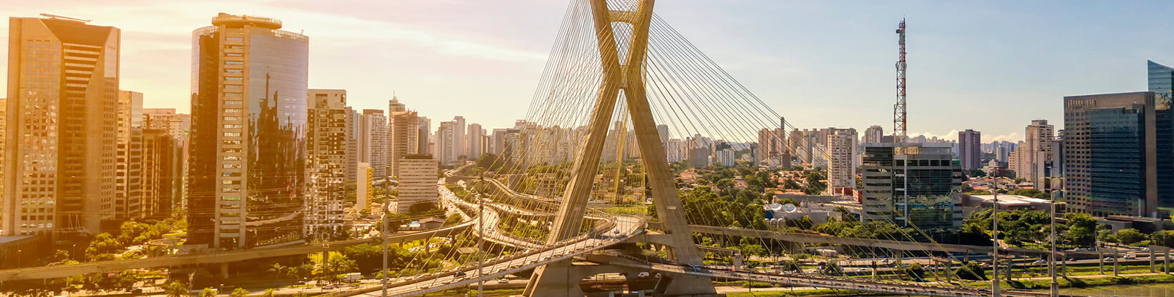

MODFLOW 6 Overview
47TH IAH Congress
São Paulo, Brazil
August 22, 2021
Notes:
Describe some of the ongoing work we are doing with MODFLOW
MODFLOW and related software distributed by the USGS is developed and supported by a growing team of USGS scientists and external collaborators. Recent MODFLOW development efforts have focused on use of unstructured and locally refined grids for constant or variable-density groundwater flow and solute transport simulation, robust handling of three-dimensional anisotropy, generalization and tracking of water transfer between packages, distributed memory parallelization, and consolidation of these core capabilities into MODFLOW 6. These capabilities make it possible to construct new types of models, such as tightly coupled nested models, that have not been possible with previous MODFLOW versions. Underlying these efforts has been the adoption of an open-development philosophy that relies on testing-based development and continuous integration practices by the core development team and by the broader MODFLOW community. Ongoing development increasingly relies on the Flopy python package for automating model construction. Resulting from these development efforts is a suite of MODFLOW programs that can be applied at local, regional, and National scales for a wide variety of complex groundwater flow and transport problems.
OASIS MCT

Slide 2
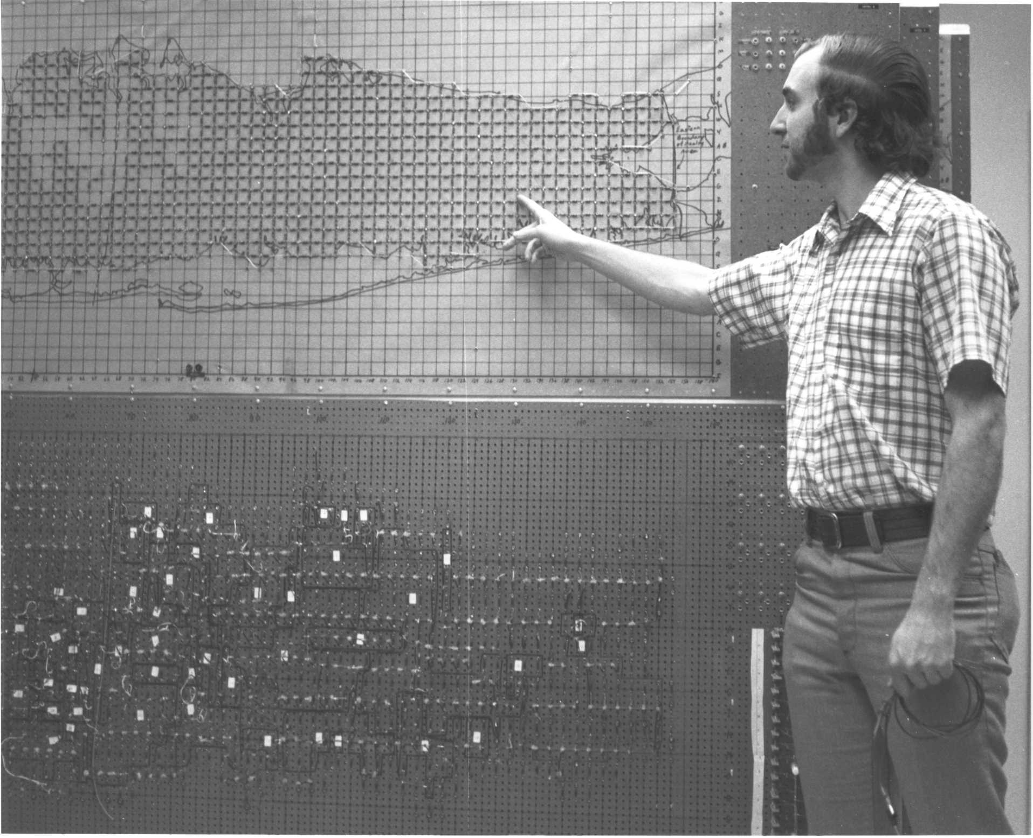
GROUNDWATER MODELING background AT THE USGS

Slide 3
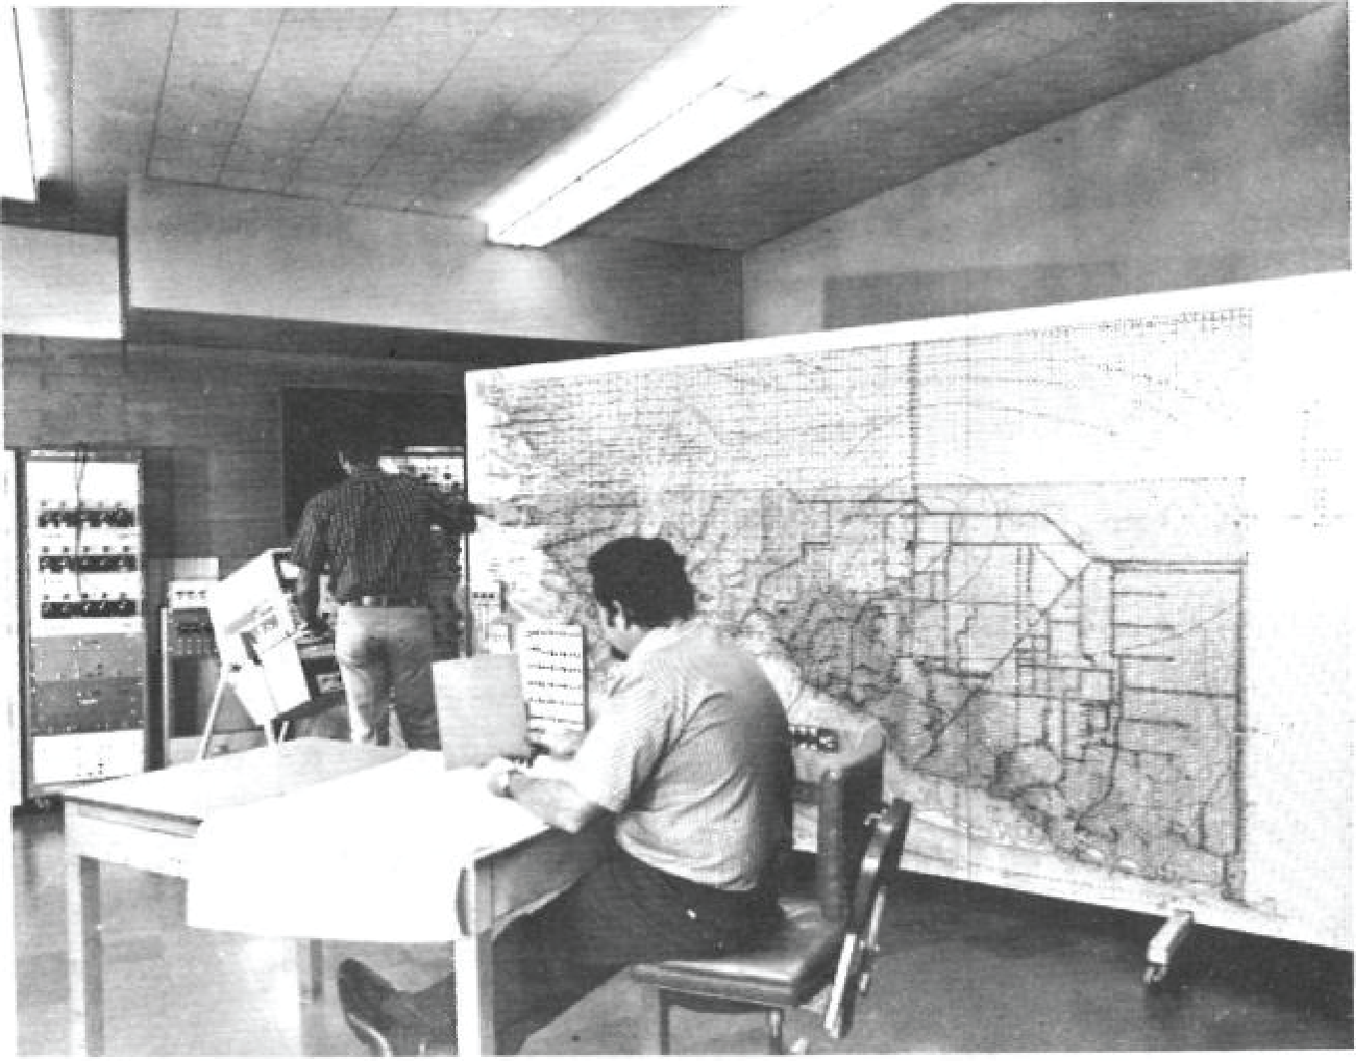

Slide 4
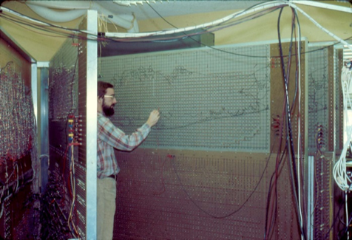

Slide 5
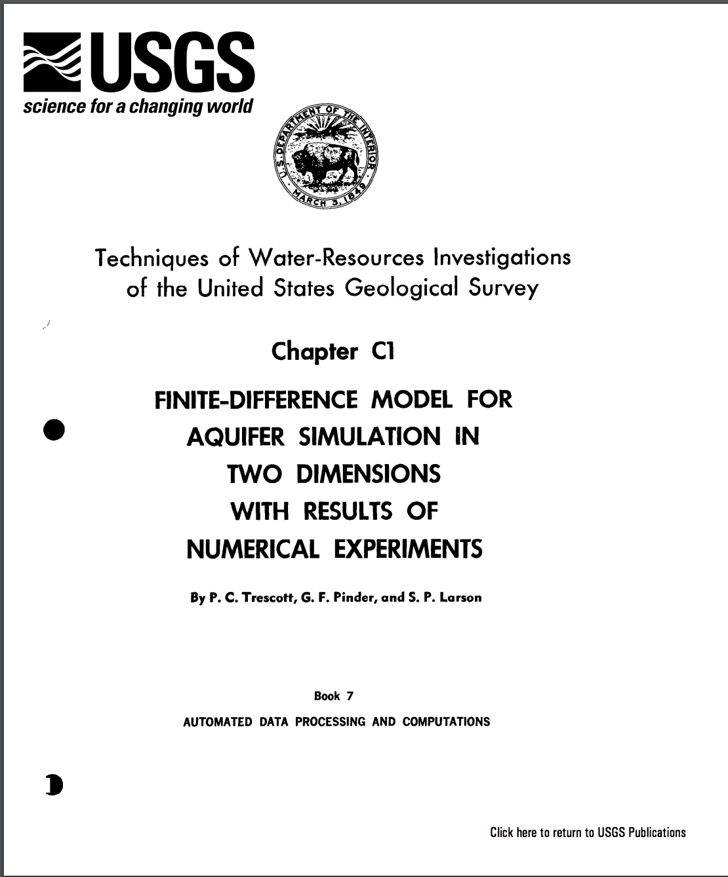
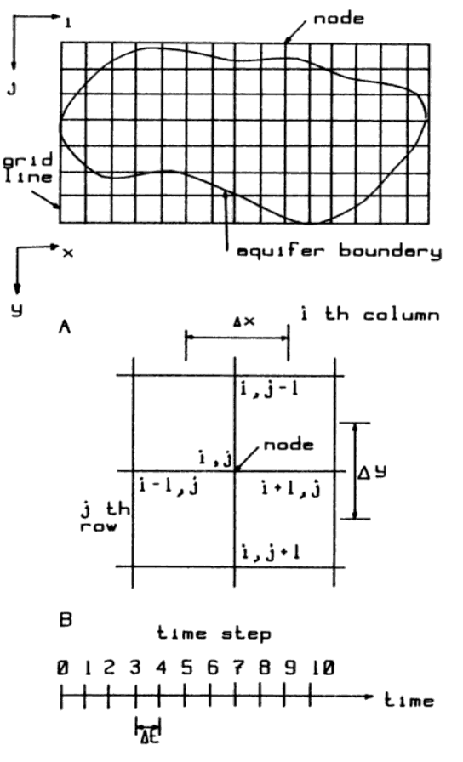

Slide 6
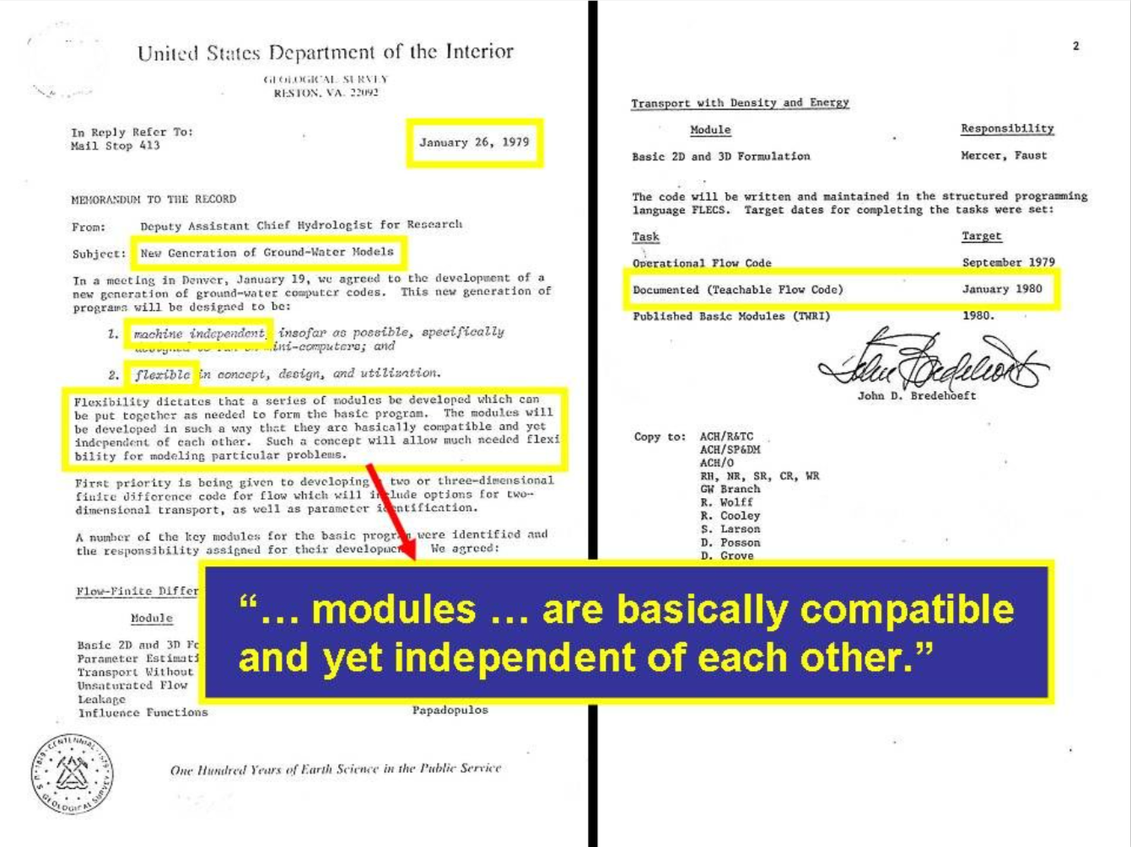
Notes:
I sometimes show this slide that I received from Lenny Konikow to give some historical context about MODFLOW. This is an internal USGS memo from John Bredehoeft in 1979 that gives the marching orders to begin developing MODFLOW. There are a few important things to note here: (1) this was 40 years ago! (2) the model should be machine independent, flexible, and teachable, Modules are independent of one another!

Slide 7
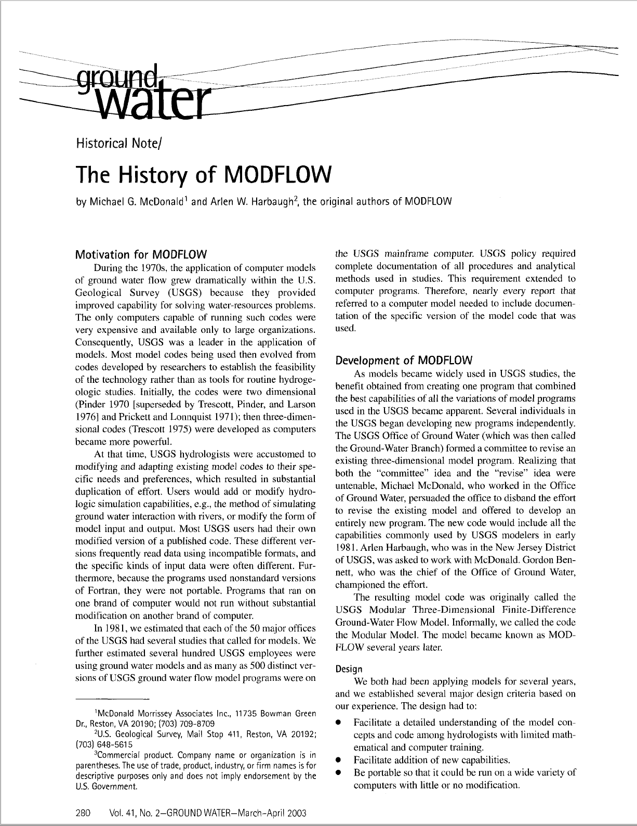

Slide 8
MODFLOW Philosophy
Core Principles
Teachable
Documented
Reliable
Robust
Efficient
Extensible
Portable
Notes:
I was lucky to have the opportunity to work with Arlen Harbaugh for a couple of years. Arlen is one of the original developers of MODFLOW. Arlen saw MODFLOW as more than just a program. MODFLOW was the philosophy before a number of core principals: …. Many believe these core principals are behind MODFLOW’s popularity. We are here 40 years later at the MODFLOW conference.

Slide 9
MODFLOW Support Environment
Groundwater Vistas GMS Visual MODFLOW. PMWIN ModelMuse Groundwater Desktop Leapfrog Hydro FREEWAT iMOD ModelViewer FloPy Graphical Interfaces and Scripting
Core Principles
Teachable
Documented
Reliable
Robust
Efficient
Extensible
Portable
Notes:
Because of it’s popularity, a wide variety of tools have been developed to support MODFLOW…

Slide 10
Solute and Heat
Transport
Landscape
Hydrology
Reactive
Transport
Parallel
Flow Path
Analysis
Groundwater Vistas GMS Visual MODFLOW. PMWIN ModelMuse Groundwater Desktop Leapfrog Hydro FREEWAT iMOD ModelViewer FloPy Graphical Interfaces and Scripting
Core Principles
Teachable
Documented
Reliable
Robust
Efficient
Extensible
Portable
Subsidence
Karst and
Pipe Flow
Unstructured
Grids
Management
Parameter
Estimation
and Uncertainty
Unsaturated
Zone
Surface Water
Flow
Notes:
Over the years, our groundwater problems have become more and more complex. As hydrogeologists and scientists , we are being asked to address karst problems, transport problems, unsaturated zone problems, etc. As a result, MODFLOW has been expanded to incorporate other processes and coupled with a variety of other models.

Slide 11
MT3DMS
MT3D-USGS
SEAWAT, SWI
GWT
GSFLOW-PRMS
SWB, HSPF, SWAT
OWHM
PHREEQC-PHT3D
PHWAT
RT3D
Solute and Heat
Transport
Landscape
Hydrology
Reactive
Transport
MODPATH
mod-PATH3DU
PATH3D
FlowSource
SAMG
PKS-MODFLOW
PKS-SEAWAT
MODFLOW 6
Parallel
Flow Path
Analysis
Groundwater Vistas GMS Visual MODFLOW. PMWIN ModelMuse Groundwater Desktop Leapfrog Hydro FREEWAT iMOD ModelViewer FloPy Graphical Interfaces and Scripting
Core Principles
Teachable
Documented
Reliable
Robust
Efficient
Extensible
Portable
Subsidence
Karst and
Pipe Flow
SUB
CSUB
MODFLOW-USG
CFP, VKD
Unstructured
Grids
Management
PESTPP-OPT
MODSIM
GWM
Parameter
Estimation
and Uncertainty
Unsaturated
Zone
MODFLOW-USG
MODFLOW 6
Surface Water
Flow
PEST
PESTPP
UCODE
UZF
HYDRUS
VSF
SFR, SWR
HEC-RAS
BRANCH
MODFLOW
ECOSYSTEM OF CODES
Notes:
This slide, which is surely incomplete, shows a MODFLOW ecosystem in which many different packages, processes, and codes have been written or coupled to solve these problems. This is an impressive collection of capabilities that use MODFLOW in one way or another.

Slide 12
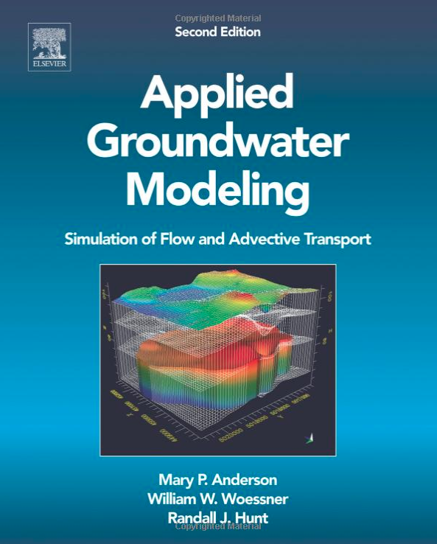
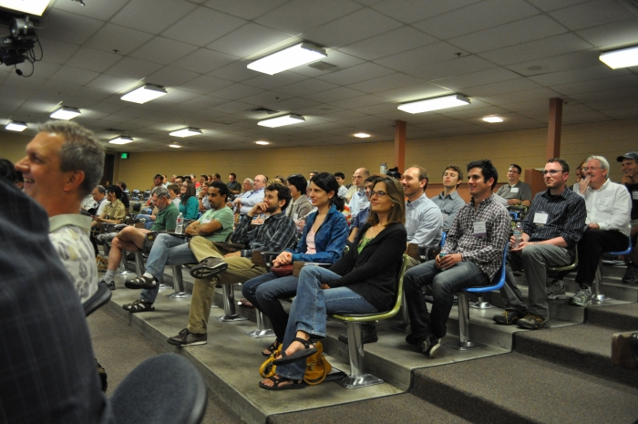
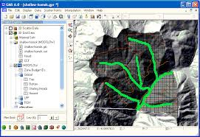
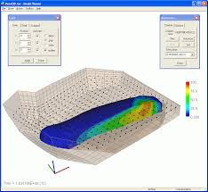
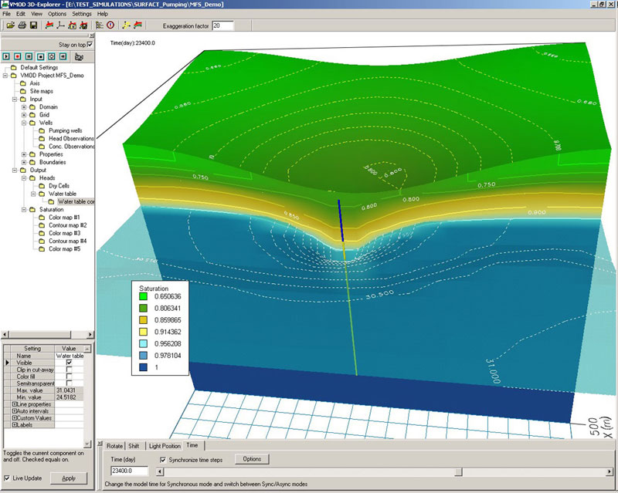
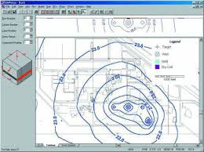
MODFLOW User Base
Academics
Private Consultants
Local, State, and Federal Government
MODFLOW and More Conference
Notes:
Most groundwater availability studies used MODFLOW

Slide 13
Evolving Simulation Needs
Groundwater issues are becoming more complex
Proliferation of new MODFLOW versions and packages
Increase in package complexity
Loss of package independence
Incompatibilities
Difficult to add other process models to MODFLOW; same grid required for all packages and processes
Notes:
----- Meeting Notes (8/13/15 09:29) -----
GW-SW interaction
Watershed hydrology
Geomechanical issues with subsidence
Chemistry
Management

Slide 14
MODFLOW Next Generation
2013 Office of Groundwater initiated a major MODFLOW revision
Rewrote MODFLOW using an object-oriented design
Consolidated capabilities from previous MODFLOW versions
Changed name from “Modular Groundwater Model” to “Modular Hydrologic Model”
Published MODFLOW 6 in 2017
Try to follow modern software design principles

Slide 15
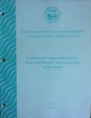
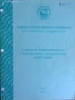

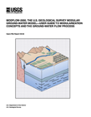
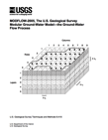
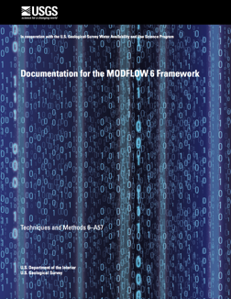
MODFLOW 6
Consolidate popular capabilities from previous MODFLOW versions (2005, NWT, USG, LGR, …)
Improve solution technique
Modernize code and input structure
Support multi-model simulations
Extend MODFLOW into a hydrologic simulator
New core version (Released August 2017)
1984
1988
1996
2000
2005
2017
Notes:
MODFLOW 6 will combine the best features of existing versions of MODFLOW and get rid of outdated functionality. Highly coupled and complex systems will be solved with one system of equations making this MODFLOW version much faster than with previous versions of MODFLOW that iteratively solved the flow part, then the other parts, like transport or local grid refinement. This effort intends to modernize MODFLOW’s design to account for 20+ years of improvements in software design and essentially making MODFLOW a more of a hydrologic simulator.

Slide 16
Current MODFLOW 6 Capabilities
MODFLOW 6
Groundwater Flow (GWF) Model (released Aug 2017)
Compaction and Subsidence (CSUB) Package (released Dec 2019)
Groundwater Transport (GWT) Model (released Oct 2020)
Coupled Variable-Density Flow and Transport (released Oct 2020)
MODFLOW API (released Jun 2020)
Related Programs
FloPy
MODPATH
MT3D-USGS
Notes:
One of the reasons for this presentation is to let you know about some of the new MODFLOW capabilities that have been released recently
We started working on MODFLOW 6 in about 2013.
At that time (and even today) there were lots of different flavors of MODFLOW (2005, USG, NWT, SEAWAT, GWM, ...), and we wanted to bring them together into a cohesive new framework
The idea was to modernize the code and make it easier to couple with other models.

Slide 17
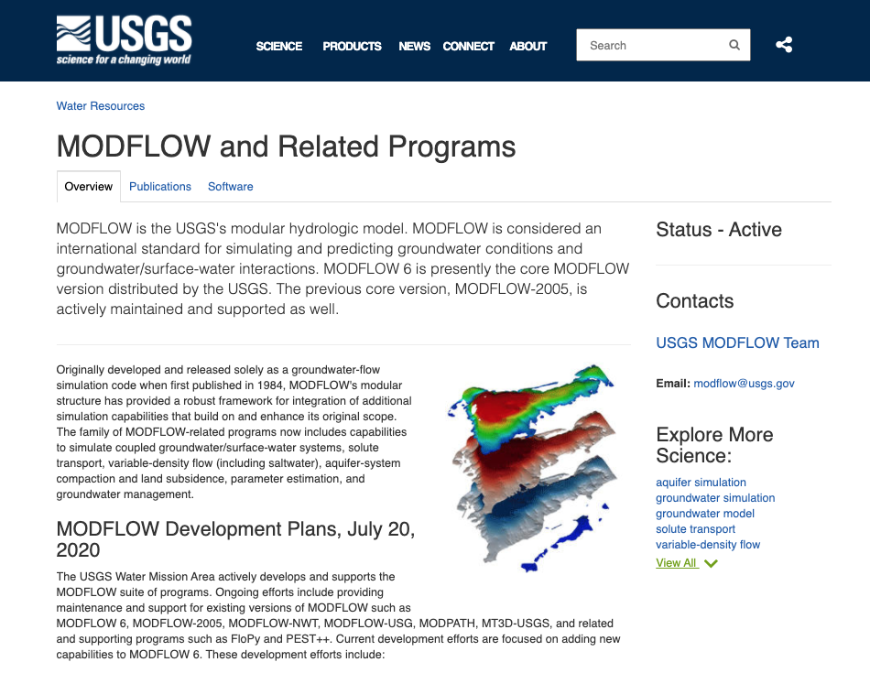
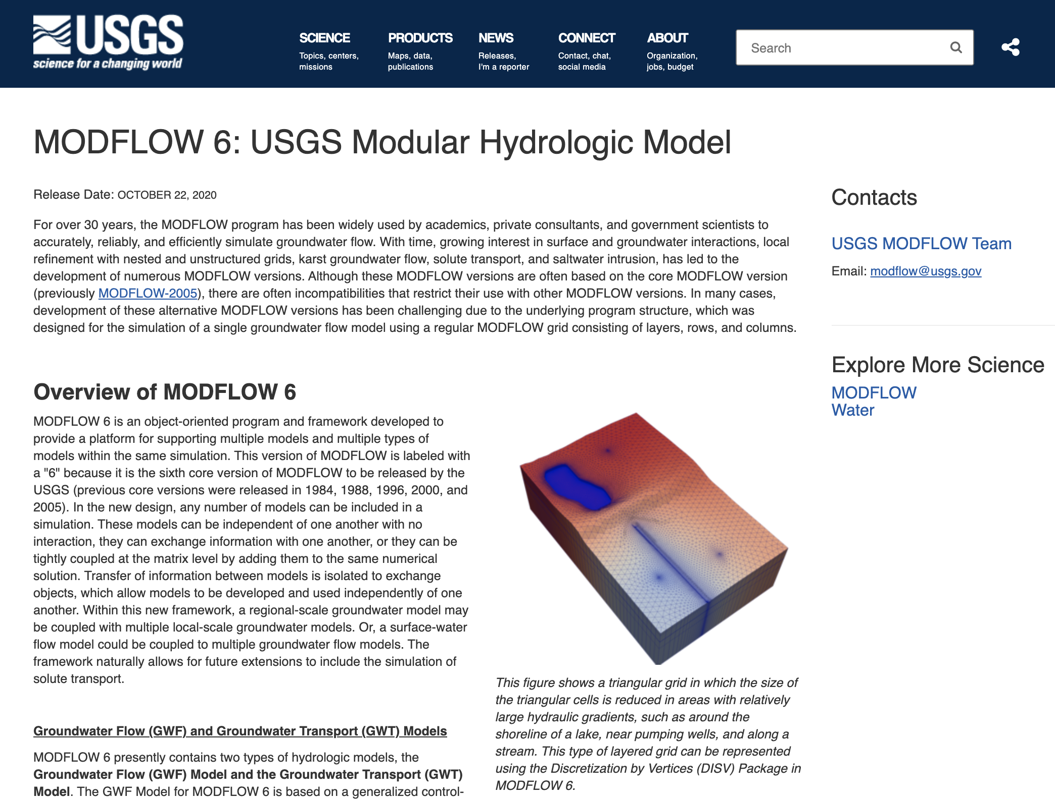
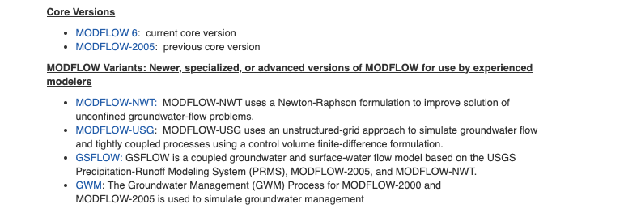
MODFLOW Distribution

Slide 18
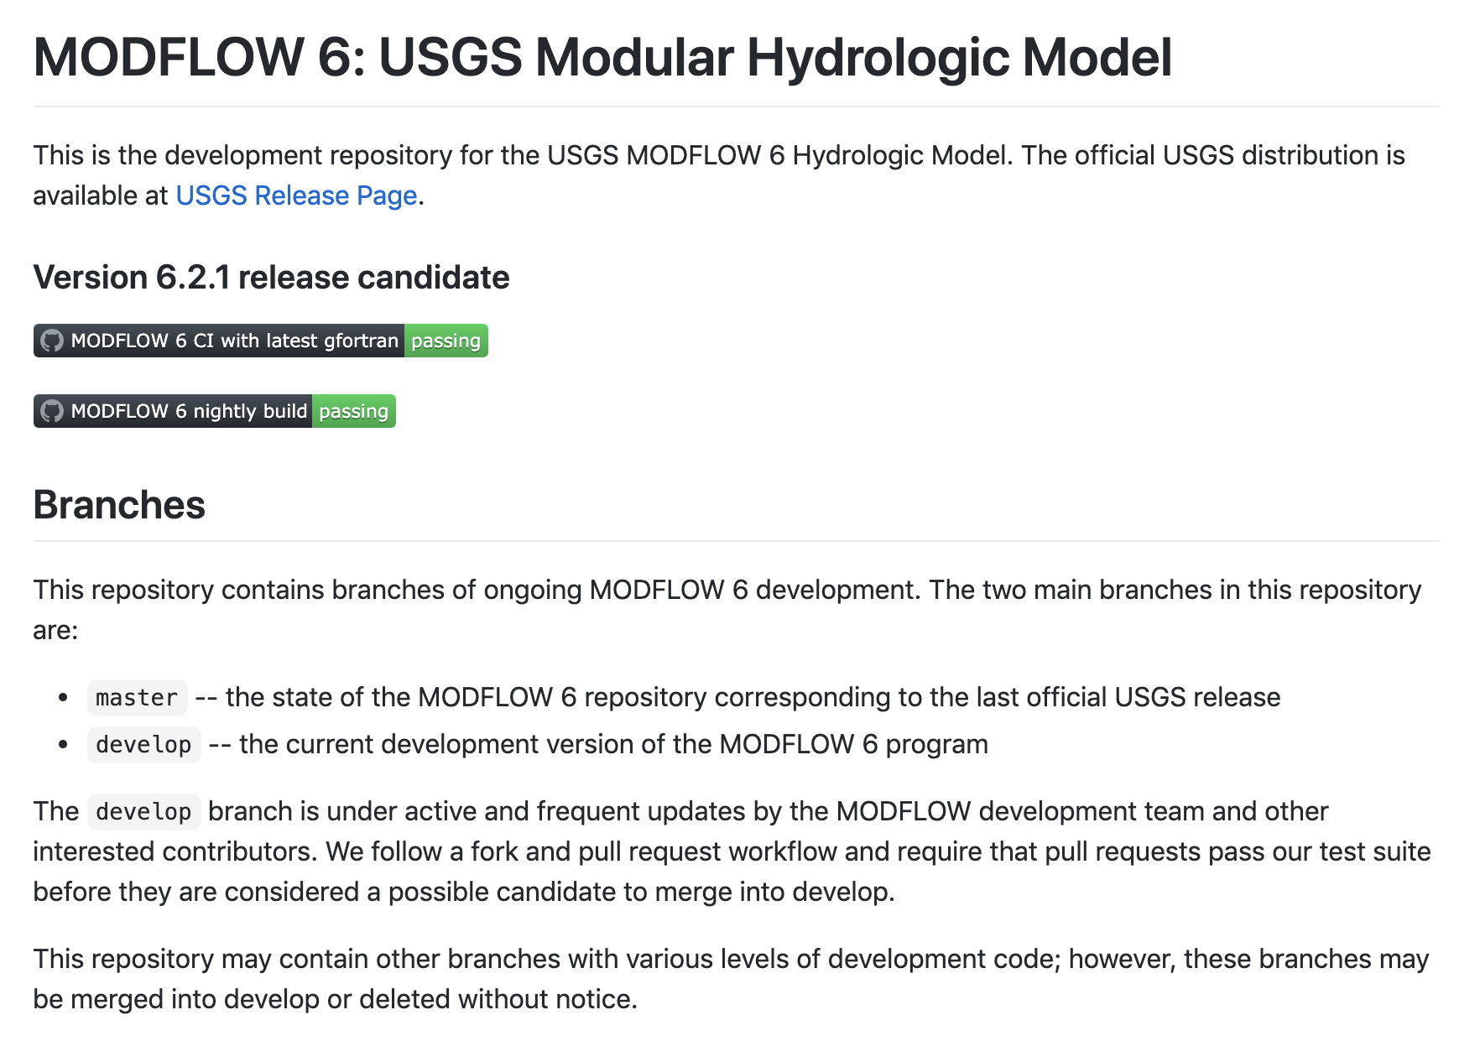
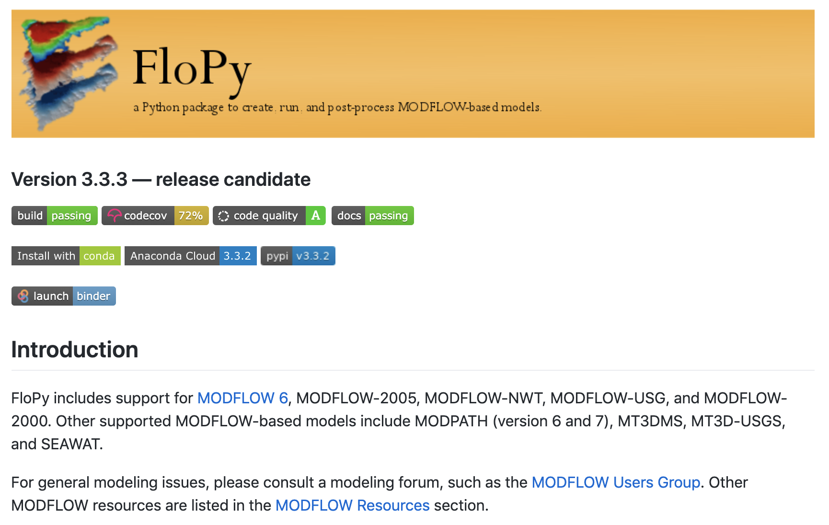
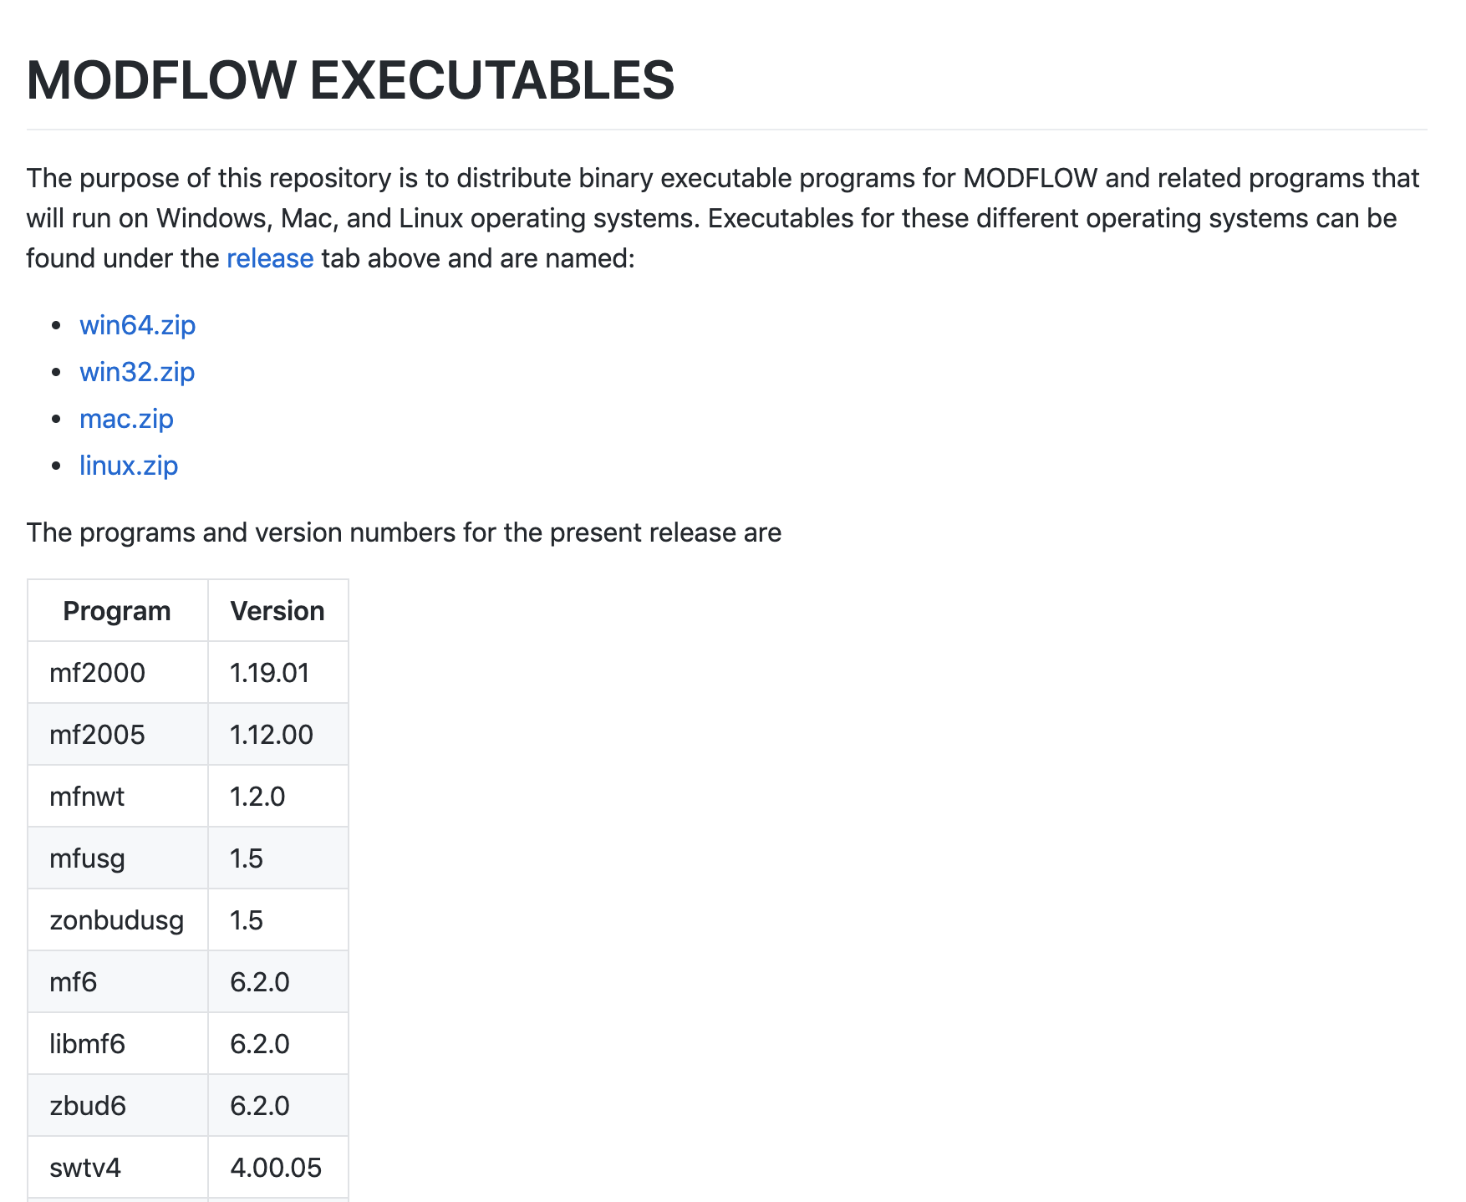
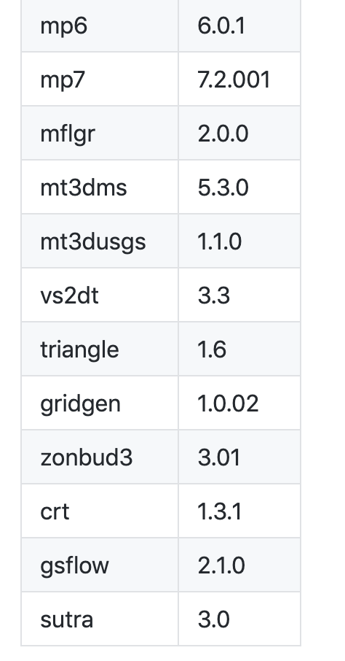
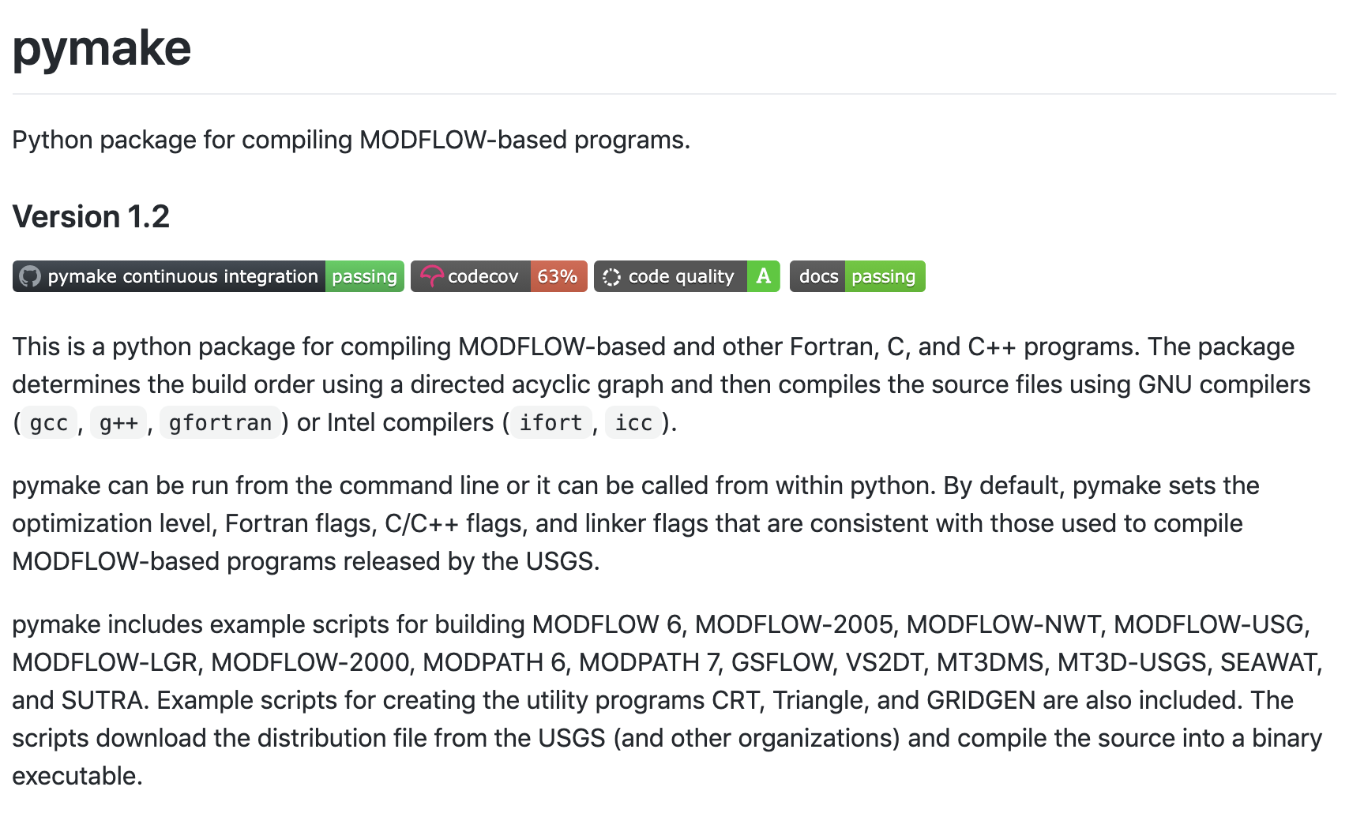
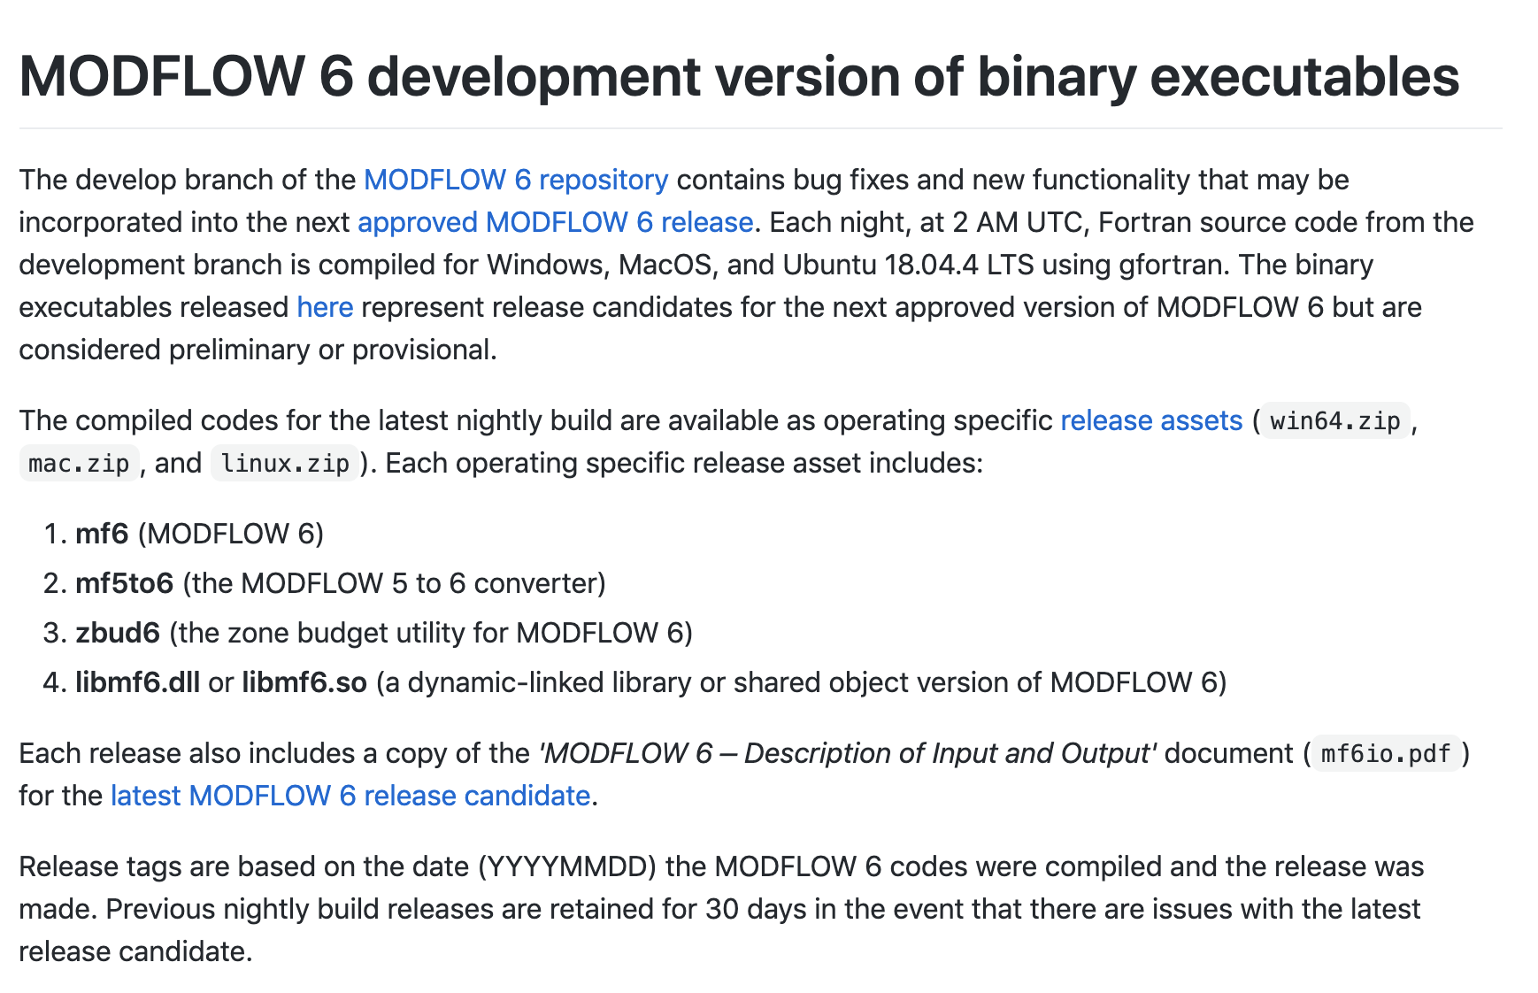
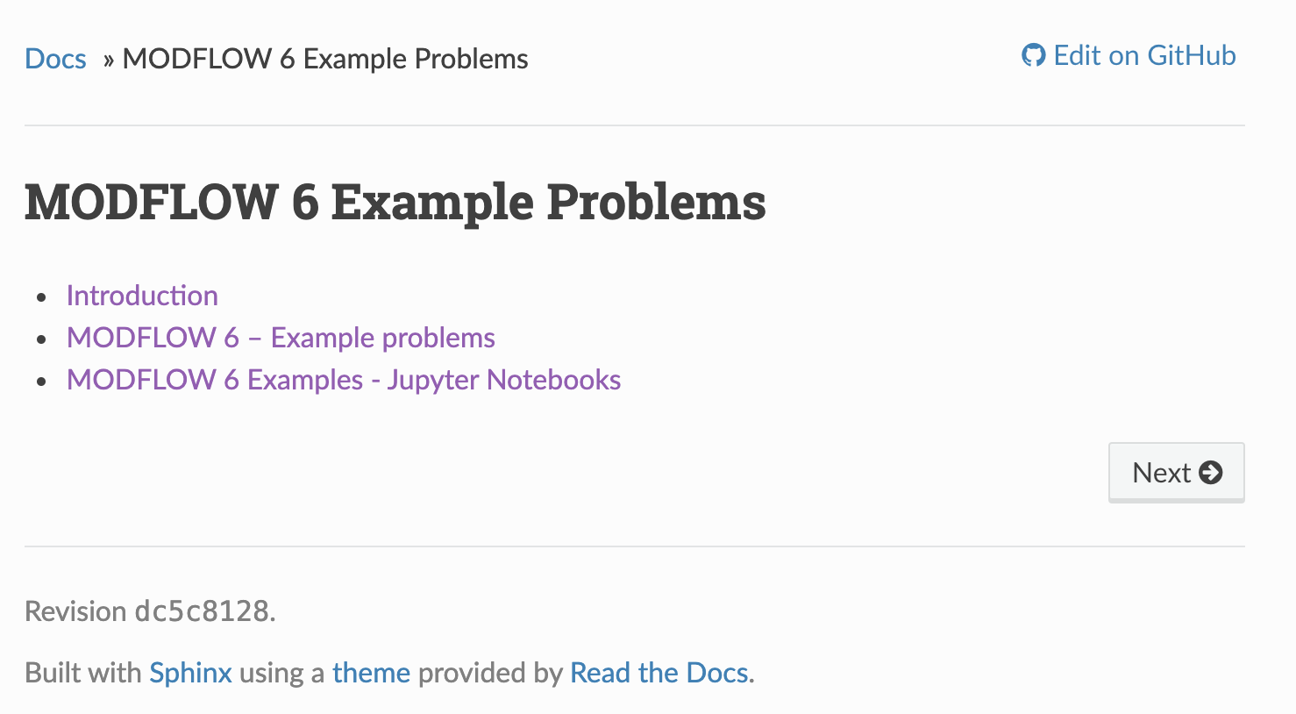
Additional Online Resources
Main Repository
FloPy
Executables
Pymake
Nightly Build
Examples

Slide 19
Any Questions?

